Slide 1
Fall 17 Computer Networks
PG3 Tutorial and C Refresher
https://www3.nd.edu/~dwang5/courses/fall18/
1

Slide 2
C Programming Refresher
General Tips | Structs | Pointers | Buffers

Slide 3
General tips
USE FUNCTIONS (PLEASE)
C can be hard to read and debug, don’t make your life more difficult
Reusability will make debugging easier!
So will conciseness!
Also use header files
Should not be rewriting functions that occur in both the client and server
Ex:
utilities.h:
int readFile(char* buffer, char* fname) {
...
}
client.c:
#include ”utilities.h” ...
server.c:
#include “utilities.h” ...

Slide 4
Structs
Example:
//declaration
struct Message {
char type;
char sender[10];
char content[1000];
};
//instantiation
struct Message m;
m.type = ‘A’;
m.sender = “John”;
m.content = “hi”;
//OR
struct message m = {
‘A’, “Jack”, “hi”
};
User defined data type
Allows different data types to be grouped together in one object
Structs, like classes in C++, hold items that belong together
Can be very useful for PG3

Slide 5
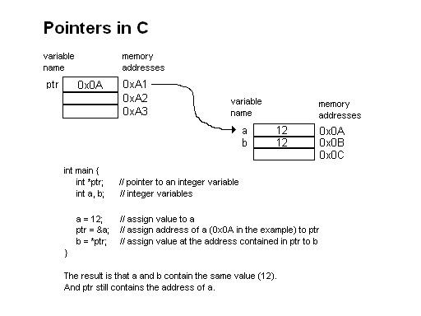
Pointers
Dereferencing pointers
//SIMPLE EXAMPLE
int a = 6;
int* ptr = &a;
//now ptr points to addr(a)
int b = *ptr;
int c = &ptr;
// b=6, c is double pointer
//WITH STRUCTS...
struct message m = {
‘A’, “Jack”, “hi”};
struct message * m_ptr = &m;
//notice -> syntax
char* sender = m_ptr->sender;
//equivalent to
char* sender = (*m_ptr).sender;

Slide 6
Buffers/malloc
Malloc – for dynamically allocating memory
void * malloc( size_t size);
Allocates a block of memory of size bytes and returns a pointer to the starting memory location of that block
Must free memory allocated with malloc when done with it to avoid memory leaks
Common mistake – sizeof
char buf1[100];
char * buf2 = malloc(100);
int size1 = sizeof(buf1); //100
int size2 = sizeof(buf2); //size of a pointer
// SIZE1 != SIZE2 !!!!!!!

Slide 7
PG 3 Introduction

Slide 8
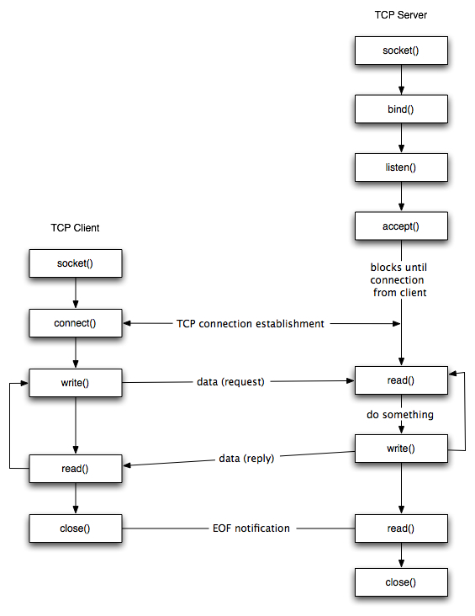
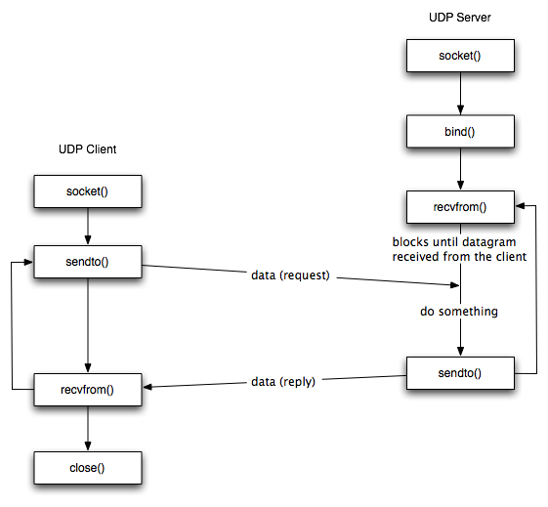
Review: TCP vs UDP
UDP Socket vs. TCP Socket
8
Source: http://www.cs.dartmouth.edu/~campbell/cs60/socketprogramming.html

Slide 9




PG3 – Overview
In PG4, you will build a prototype of online chat room.
This program allows multiple users to register and log on to a chat room server simultaneously.
The users can broadcast messages to all users (public mode), or send private message (direct mode) to a specific user.
User 2
User 1
User 3
Message
Message
Message
Chat Room Server
9

Slide 10

PG3 – User Registration
User first needs to register an account by setting up a username and password.
Registration Protocol:
1) Alice connects to server: ./chatclient student00.cse.nd.edu 41100 Alice
2) Server checks New User? Yes - > Prompt for password
3) Alice sets password
4) Server stores user account into a file
Users.txt
1) My name is Alice
“Alice, pass”
2) Welcome Alice! Password?
3) My password is “pass”
Alice
Server
10
10

Slide 11
PG3 – User Login
A registered user can login with his/her credentials.
Login Protocol:
1) Alice connects to server: ./chatclient student00.cse.nd.edu 41100 Alice
2) Server checks Existing User? Yes - > Prompt for password
3) Alice enters password
4) Server checks password correct? No - > Prompt for password again
5) Server checks password correct? Yes - > Success!
Users.txt
“Alice, pass”
…
1) My name is Alice
2) Alice Exist? (Yes)
2) Welcome Alice! Password?
4) Password Match? (No)
5) Password Match? (Yes)
3) My password is “pass1”
4) Wrong Password. Re-enter
Alice
5) My password is “pass”
Server
11
11

Slide 12
PG3 – Public Messaging
A logged in user can send broadcasting messages.
Public Messaging Protocol:
1) Server prompts for operation P for public message, D for direct messaging,
Q for quit
2) Alice enters P
3) Server prompts for message
4) Alice enters message.
5) Server redirects message to all online users
Hi all!
Alice: Hi all!
1) Operation - P, D, Q?
Alice
2) Public Message (P)
Alice: Hi all!
Server
3) Please Enter Message:
12
12

Slide 13
PG3 – Direct Messaging
A logged in user can send private messages to a specific user.
Direct Messaging Protocol:
1) Server prompts for operation P for public message, D for direct messaging,
Q for quit
2) Alice enters D
3) Server prompts for username then 4) message
Note: server must keep a list of all online users (stored in memory).
If Alice enters invalid user, server will prompt for user name again.
Jeff
1) Operation - P, D, Q?
Online List:
{Alice, Jeff, Zach}
Hi Jeff!
2) Direct Message (D)
Alice: Hi Jeff!
3) Enter name:
Zach
Alice
3) Jeff
Server
4) Enter message:
13
13

Slide 14
PG3 – User Exit
A logged in user can exit the program by using the E command.
Exit Protocol:
1) Server prompts for operation P for public message, D for direct messaging,
Q for quit
2) Alice enters Q
3) Server removes Alice from online list
4) Client program close socket and exit
Online List:
{Alice, Jeff, Zach}
1) Operation - P, D, Q?
2) Quit (Q)
Alice
Server
14
14
14

Slide 15
PG3 – Multithreading
Multithreading is the ability of a CPU in a multi-core processor to execute multiple processes or threads concurrently
Why Multithreading? Concurrency!
Jeff is interacting with server (e.g., server is prompting Jeff for command options)
Alice is sending broadcast message to Jeff and Zach
Zach is sending private message to Alice
Both clients and server need to handle multiple messages at the same time!
Jeff
Enter Message:
Message to All
Zach
Message to Alice
Server
Alice
15
15
15

Slide 16
PG3 – Multithreading
Use pthread library http://www.yolinux.com/TUTORIALS/LinuxTutorialPosixThreads.html
pthread_create() // create new thread
pthread_join() //suspend current thread until a thread finishes
pthread_exit() // exit a thread
Main Program
Request 1
Request 2
Request 1
Request 2
Thread 1
Thread 2
16

Slide 17
PG3 – Multithreaded Server
Server – needs to interact with multiple users concurrently.
Recommended solution:
Main thread (socket listener): keep listening for new connections
Create a new thread (client handler) for each online user.
Main Thread
User 1
Socket Listener
User 2
User 3
Handle user3
Handle user1
Handle user2
Thread 1
Thread 2
Thread 3
17

Slide 18
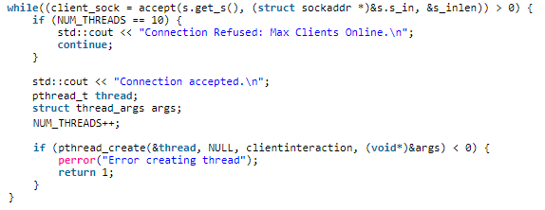
PG3 – Multithreaded Server
Server – needs to interact with multiple users concurrently.
Recommended solution:
Main thread (socket listener): keep listening for new connections
Create a new thread (client handler) for each online user.
New Connection?
Main Thread
User 1
Socket Listener
User 2
User 3
New thread for each connected client
Handle user3
Handle user1
Handle user2
Thread 1
Thread 2
Thread 3
18

Slide 19
PG3 – Multithreaded Client
Client – needs to handle both messages from server and messages from other clients.
Recommended solution:
Main thread (socket client): normal client operations (prompt user for input, interact with server)
Another thread (message handler): handle each message
“Hi Zach!”
Socket Client
Client Main Thread
“Hi All!”
1) Operation – P, D, Q?
“Hi Zach!”
Message Handler
“Hi All!”
1) Operation – P, D, Q?
Another Thread
19

Slide 20
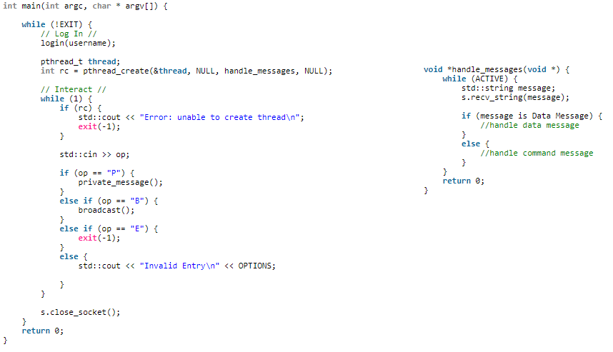
PG3 – Multithreaded Client
Client – needs to handle both messages from server and messages from other clients.
Recommended solution:
Main thread (socket client): normal client operations (prompt user for input, interact with server)
Another thread (message handler): handle each message
Create an extra thread at the start
“Hi Zach!”
Socket Client
Client Main Thread
“Hi All!”
1) Operation - B, P, E?
Handler simultaneously distinguishes
and handles messages
“Hi Zach!”
Message Handler
“Hi All!”
Normal client operations
(Same as PG1&2)
1) Operation - B, P, E?
Another Thread
20

Slide 21
PG3 – Message Frames
Client must understand different types of messages
Two types:
Data Message
Command Message
“Hi Zach!”
“Hi All!”
1) Operation - P, D, Q?
Recommended solution:
Use an extra byte at the beginning of each message (e.g. “C” for command message, “D” for data message).
21

Slide 22
PG3 – More Info
Protocol: For PG3, you can use either UDP or TCP at your choice.
Programming language: C or C++
Communication Specifics: Much more open-ended than PG1-2. You decide the structure,
Testing: use 4 student machines, one as server, three as clients
22

Slide 23

PG3 – Demo
Server: ./chatserver Port
Client: ./chatclient Server_Name Port Username
Video of the demo can be found at:
https://www3.nd.edu/~dwang5/courses/fall18/programming/prog3.html
23

Slide 24
Thank You!
Questions?
24

